Slide 1
Society of Petroleum Engineer
“UN MUNDO DE OPORTUNIDADES”

Slide 2


Who we are? #WEARESPE
Completion
Drilling
Reservoir
Health, Safety & Environment
Management & Information
Production & Operation
Project, Facilities & Construction
Data Science and Engineering Analytics
119,000 Miembros
138 Países
203 Secciones
427 Capítulos Estudiantiles
SPE organiza sus actividades dentro de ocho disciplinas principales, ofreciendo novedades y programas específicos para cada área.

Slide 3
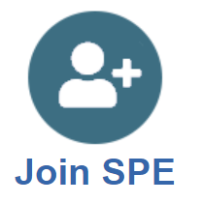
Join the SPE
PROFESIONALES
Descuentos en eventos
Precio Diferencial en libros y suscripciones en revistas
ESTUDIANTES
Becas SPE
Descuentos en libros y material de referencia
Descuentos en papers SPE
Programa de Voluntarios
… entre muchos otros
Concursos: PAPERS, PETROBOWL
Guía de un mentor
Programa de Voluntarios
https://www.spe.org/en/join/

Slide 4
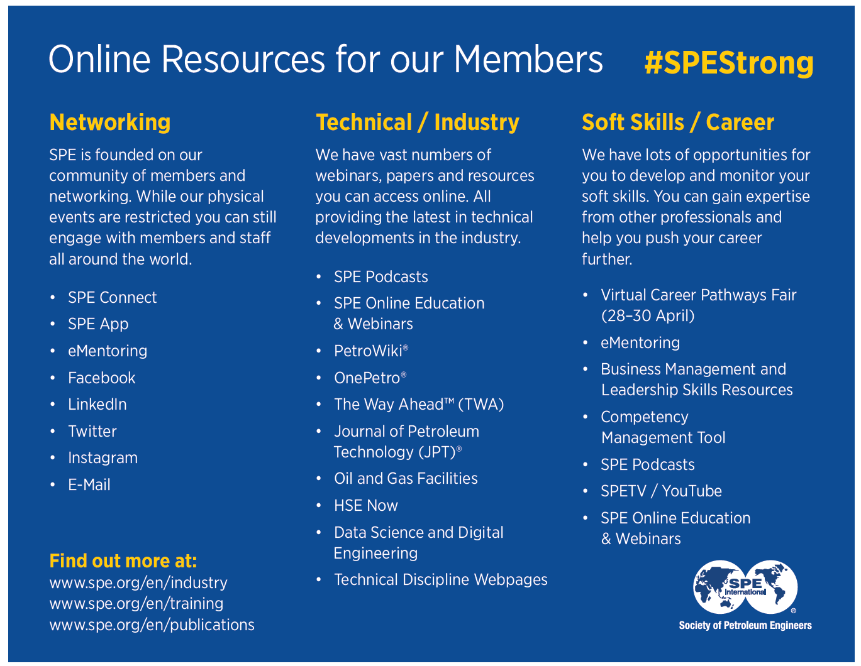

Slide 5

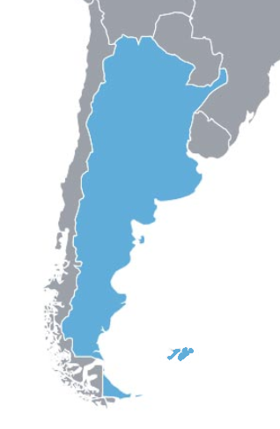


SPE in Argentina
3 Geographic Sections
Student Chapters
D&I Committees
YP / Seniors
In Patagonia Section
Student Chapters
D&I Committees
YP / Seniors
GAIA
Innovation Committee

Slide 6



SPE Patagonia
Section Established in 1996
2019, 2020, 2021
2017
2018

Slide 7
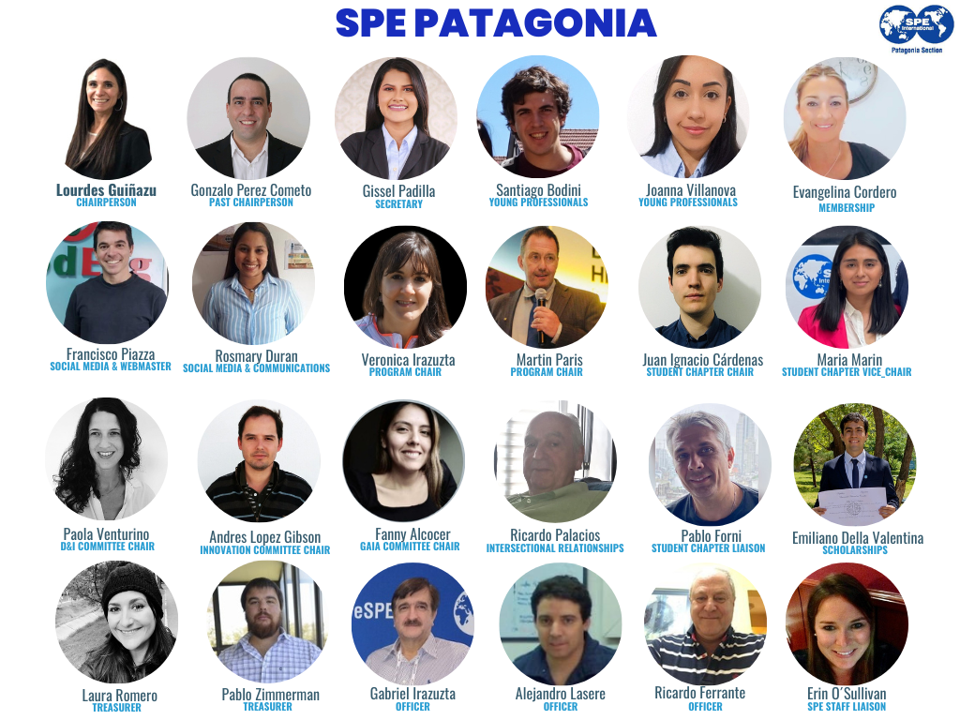
SPE Patagonia Current Board

Slide 8



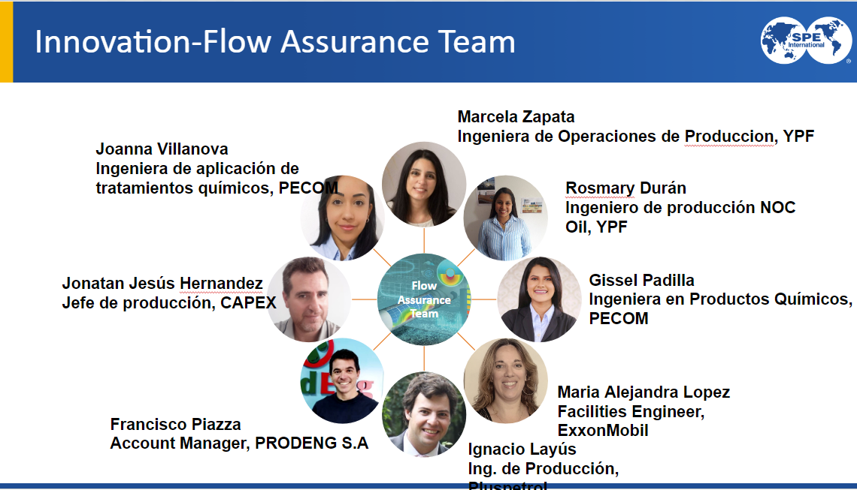
SPE Patagonia Committees

Slide 9
SPE Patagonia 2023 Activities
SPE Unconventional Symposium
DL (locals and internationals)
GAIA
conferences, trainings, interviews
D&I
STEM, Mentoring, oil women's day
Innovation
YP
YP Symposium (AR)
Urtec

Slide 10





SPE Patagonia Social Media
http://connect.spe.org/patagonia/home
SPE Patagonia
SPE Patagonia
@SPE Patagonia
spepatagonia@spemail.org

